Slide 1

APIATLAS
PROJECT PRESENTATION
Global travel guide: discover, plan and prepare your next trip
Ochilov Akhmadjon
202539468
Akhmadaliyev Ruziboy
202539434
Notes:
Introduce the project name, APIATLAS, and the two team members: Ochilov Akhmadjon (202539468) and Akhmadaliyev Ruziboy (202539434).

Slide 2

Introduction: the travel problem
01 / THE PROBLEM
Planning a trip means jumping between many apps and websites
Weather, prices and currency are checked in different places
Travelers often do not know what to see near their destination
Budgeting in an unfamiliar currency is confusing
The result is stress, wasted time and a less comfortable trip
APIATLAS
02 / 10
Notes:
Travelers today use many different tools to plan one trip. APIATLAS exists to make trips more comfortable by putting the essentials in one place.

Slide 3
Solution and project goals
02 / OUR SOLUTION
One platform for destination guides, itinerary, weather, currency and inspiration
Turn any destination into a clear seven-day outline
See nearby places, local weather and cost estimates together
Make budgeting easy with currency conversion
Help every traveler feel prepared and comfortable
APIATLAS
03 / 10
Replace with a screenshot of the APIATLAS home page
Notes:
Our goal is to bring the practical pieces of a trip into one website so travelers can prepare faster and with more confidence.

Slide 4

Target users
03 / AUDIENCE
Tourists planning a first visit to a new place
Students and young travelers on a tight budget
Families who need weather and cost details in advance
Business travelers who want quick, reliable trip information
Culture lovers who enjoy books and films about a destination
APIATLAS
04 / 10
Notes:
APIATLAS is useful for anyone who wants to travel with less stress, from students to families to business travelers.

Slide 5
Discover: the front page
FEATURE 01 / DISCOVER
Hero slider that highlights featured destinations such as Kyoto
Inspiration cards for Paris, Tokyo, Istanbul and Bali
Search box to find any destination worldwide
Quick links to the trip planner, weather, currency and media library
APIATLAS
05 / 10
Notes:
The Discover section is the front page. It inspires users with destinations and leads them into the other tools.

Slide 6
Trip planner: build your trip
FEATURE 02 / ITINERARY
Search a city or country to open a destination guide
Discover nearby places around the destination
Turn the destination into a seven-day outline
See local weather and cost estimates
Use hotel links to continue planning
APIATLAS
06 / 10
Notes:
The trip planner turns a destination into a practical plan: nearby places, a seven-day outline, weather, costs and hotel links.

Slide 7
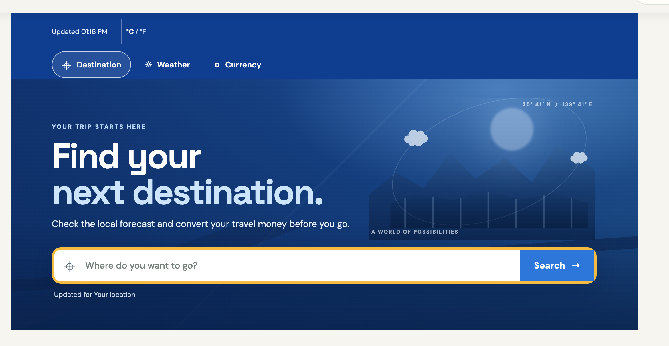
Weather: pack for the place
FEATURE 03 / WEATHER
Check conditions for destinations around the world
Use forecasts to decide what to pack
Plan outdoor activities around good weather
Search any city to see its weather instantly
APIATLAS
07 / 10
Notes:
Weather helps travelers prepare: what to wear, what to pack and when to plan outdoor activities.

Slide 8

Currency: get budget-ready
FEATURE 04 / CURRENCY
Convert between currencies in seconds
Compare travel spending in local money
Prepare a realistic budget before the trip
Avoid surprises when paying abroad
APIATLAS
08 / 10
Notes:
The currency converter helps travelers understand prices in their own money and plan their spending.

Slide 9
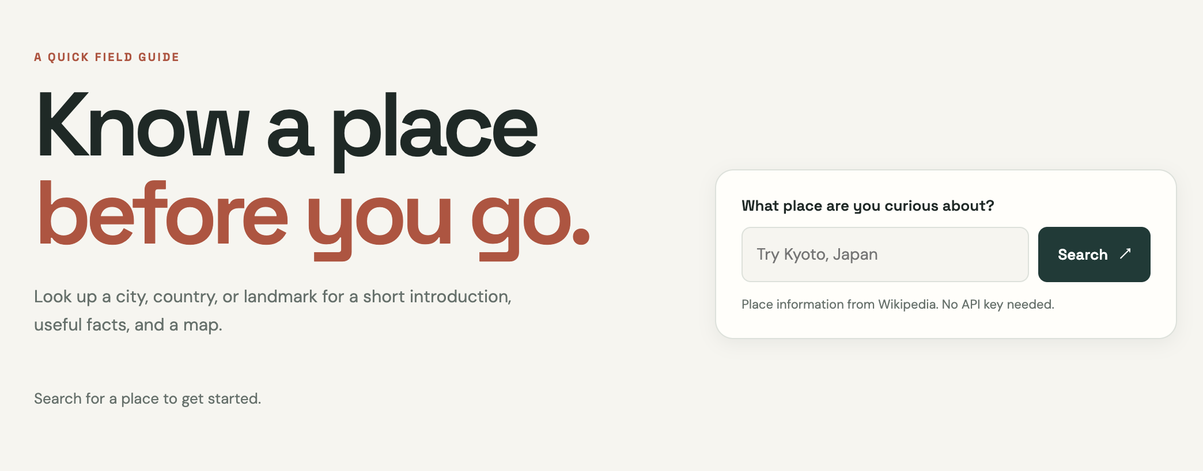
Place info: learn about a place
FEATURE 05 / PLACE INFO
Purpose: help travelers learn about a destination before they go
Search any city, country or landmark
See a photo, a short description and key facts
Open the place on a map with one click
Works on phones and on computers
APIATLAS
09 / 10
Notes:
The Place info page replaces our earlier media library. Travelers type a place and get a photo, a short description, key facts and a map link, so they know what to expect before the trip.

Slide 10




Future improvements
WHAT COMES NEXT
User accounts
Mobile and offline
Save trips, favorites and itineraries to a profile.
An installable app that still works without internet.
More languages
Smart suggestions
Offer the guide to travelers around the world.
Itineraries based on interests and budget.
APIATLAS
10 / 10
Notes:
These are the four improvements we plan to make next: user accounts, a mobile and offline version, more languages, and smart suggestions. Thank you for listening.

